Slide 1
Interval Timing
Hedderik van Rijn
Department of Experimental Psychology
University of Groningen

Slide 2
Interval timing is the capacity to estimate the duration of (short) intervals

Slide 3
It’s a type of “automatic” timing that is important for cognitive control, for decision making in faster paced tasks, for making inferences...
Interval timing is the capacity to estimate the duration of (short) intervals

Slide 4


Slide 5

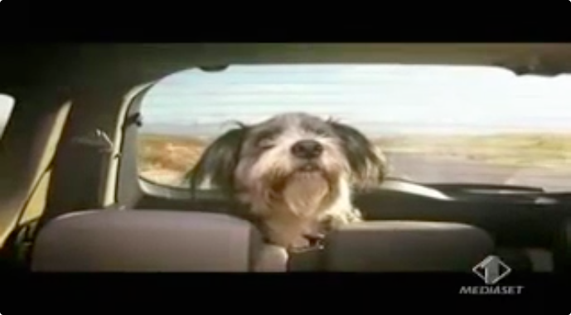


Slide 6
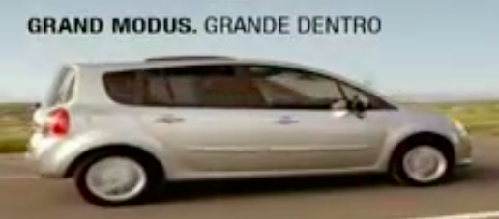
Interval timing
Notes:
Interestingly, one doesn’t need to resort to advertising agencies to observe interval timing. For example, …

Slide 7
“Unlike vision and audition, there are no dedicated sensors for time. Yet the passage of time is as perceptually salient as the color of an apple or the timbre of a tuba.” (Ivry 2004)
Interval timing is the capacity to estimate the duration of (short) intervals

Slide 8
Why bother with time?
Timing is automatic, and implicit.
Timing is implicit in many tasks / settings
Language:
Using pauses as a rhetorical tool.
Turn-taking in conversation.
Human-Environment Interaction:
Adapting to the pace of the environment.
Norman’s evaluation cycle.
Psychological Experiments

Slide 9
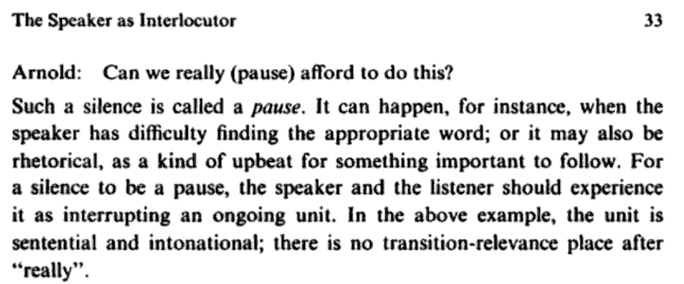
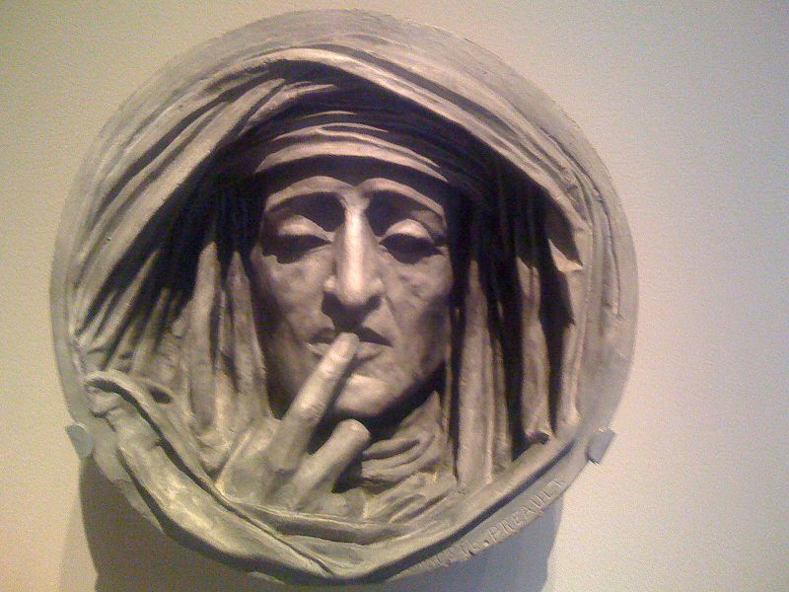
Levelt (1989) Speaking: From Intention to Articulation
Notes:
Timing as a rhetorical tool.

Slide 10
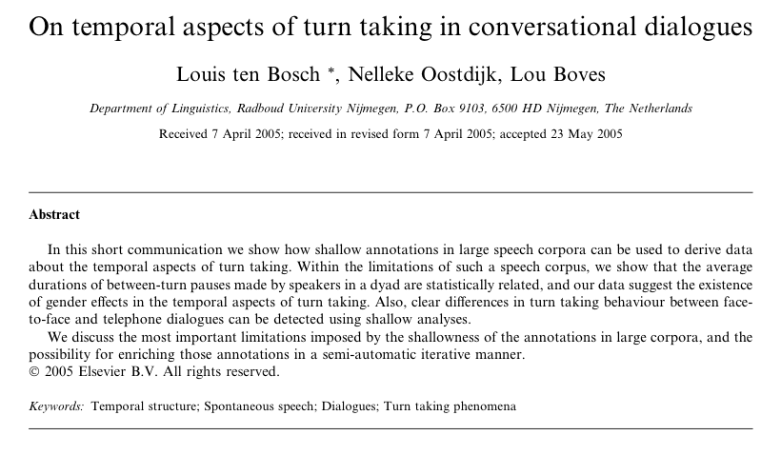
[W]e [..] derive data about the temporal aspects of turn taking. […] [W]e show that the average durations of between-turn pauses made by speakers in a dyad are statistically related […]. Also, clear diﬀerences in turn taking behaviour between face- to-face and telephone dialogues can be detected […].
Notes:
Pauses as turn-taking information.

Slide 11
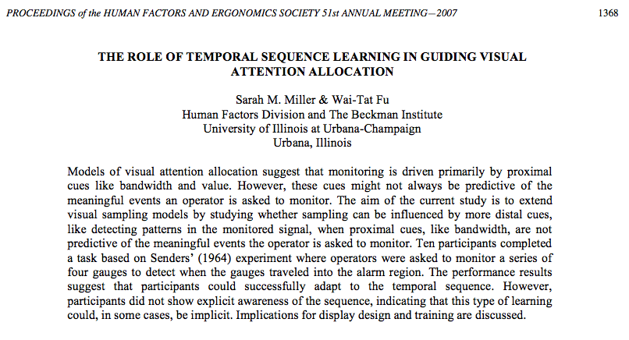
\
Ten participants completed a task based on Senders' (1964) experiment where operators were asked to monitor a series of four gauges to detect when the gauges traveled into the alarm region. The performance results suggest that participants could successfully adapt to the temporal sequence. However, participants did not show explicit awareness of the sequence, indicating that this type of learning could, in some cases, be implicit.
Notes:
Adaptation to the environment

Slide 12

Notes:
Norman’s evaluation cycle: delay between action and consequence.

Slide 13
And “typical” psychological experiments
Participants are instructed to be aware of the temporal dynamics of their performance:
“be as fast and as accurate as possible”
But also when we asked participants to be “faster”.
Speeded Performance

Slide 14
And it is a capacity shared by many types of animals…
Interval timing is the capacity to estimate the duration of (short) intervals

Slide 15
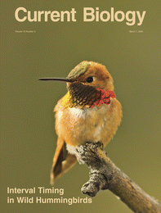
Nectarivores are excellent timers
Henderson, Hurly, Bateson, & Healy (2006)
Notes:
Free-living rufous hummingbirds

Slide 16
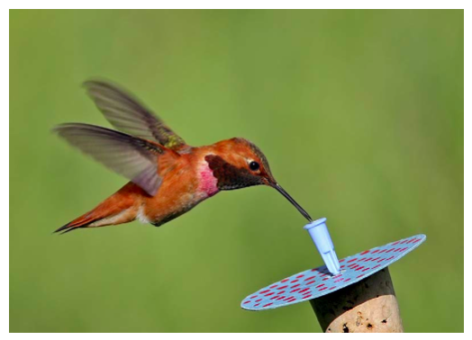
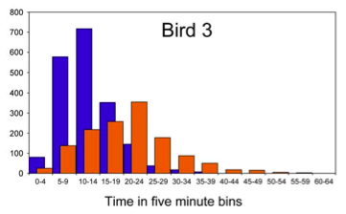
Notes:
Some artificial flowers refilled every 10 minutes, others, distinguishable by color and location, refilled every 20 minutes.

Slide 17

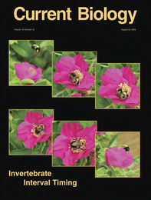
Bees
Boisvert & Sherry (2006)

Slide 18
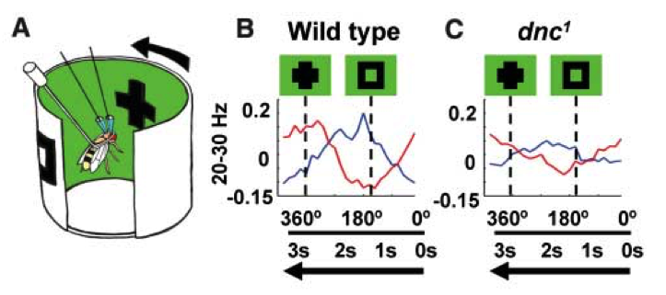
And maybe even drosophila..
Van Swinderen (2007), Science
Notes:
dnc: short-term memory mutants

Slide 19
And in humans…

Slide 20
Temporal Generalization

Slide 21

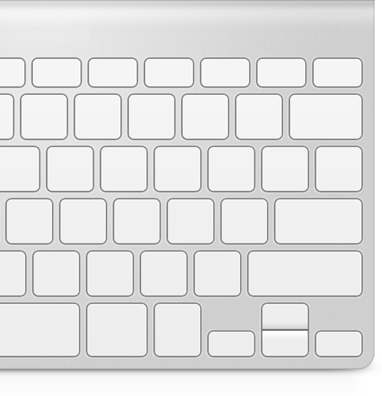

Slide 25
Red or Green
longer?

Slide 26
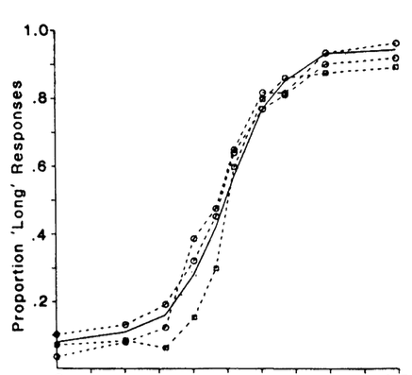
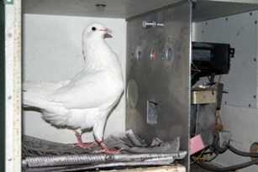
P(“Red longer”)
http://www.uky.edu/~zentall/recentpublication.html
Green longer
Equal
Red longer
Adapted from Heinemann (1984) Annals NY Academy of Sciences

Slide 27
Ready-Set-Go

Slide 28
Notes:
Temporal generalization

Slide 33
Reproduction

Slide 39
Correct!
Too fast!
Too slow!

Slide 40
Results: Scalar Property

Slide 41
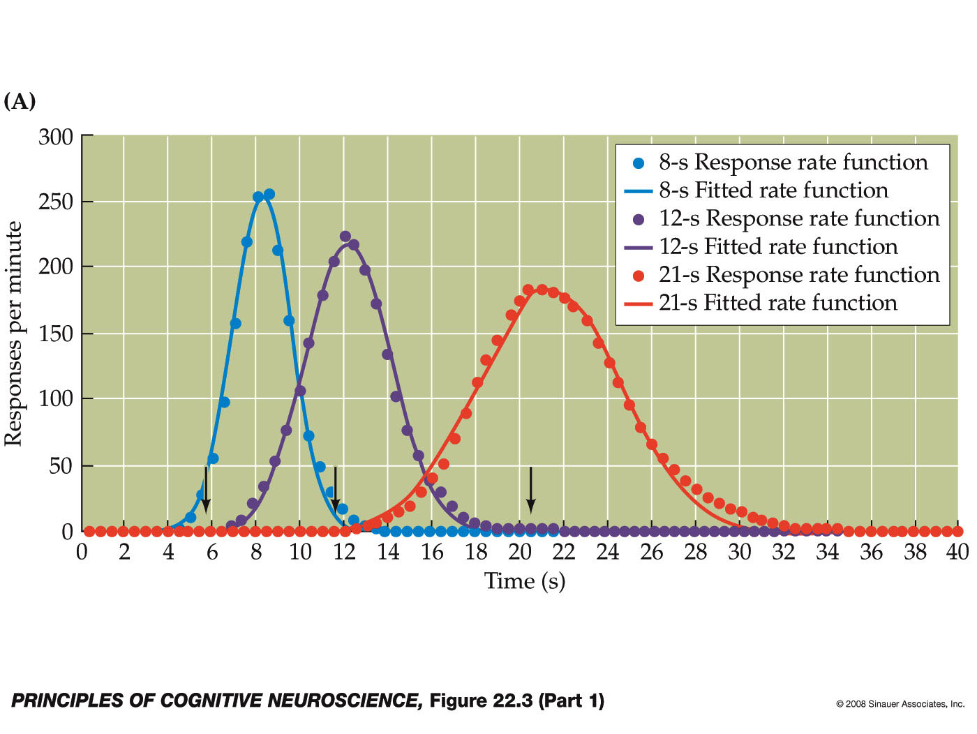
Peak Procedure

Slide 42
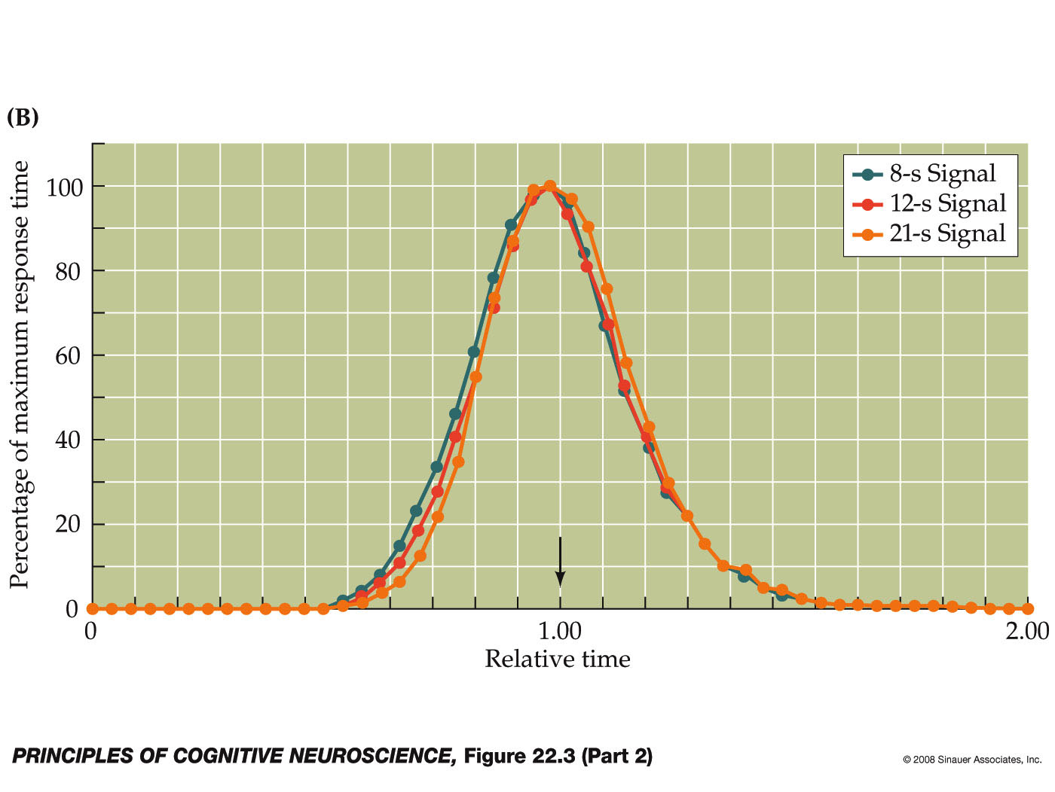
Scalar Property

Slide 43
What drives interval timing?

Slide 44
Human Interval Timing
150 years ago:
Von Baer (1860, perceptual moment), Mach (1865, Weber’s law), Donders (1868, chronometry), Vierordt (1868)
50 - 25 years ago:
1960s-1980s: Information processing models (e.g., Michon, 1967: “Formal lay-out of ‘time sense’ underlying most historical theories”)
Recent revival, both behavioral and neuroscience based.

Slide 45
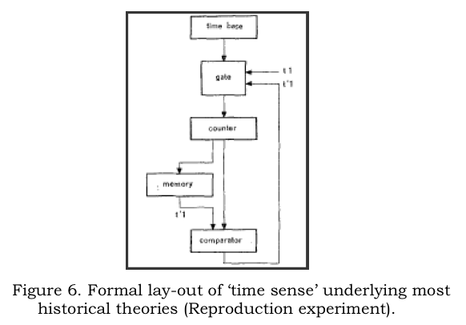
Information Processing Approaches to Interval Timing
(e.g., Creelman, 1962, Michon, 1967, Gibbon, 1977, Treisman, 1963)
Notes:
Temporal behavioral requires more than “just time”, it has to be embedded in a broader cognitive system.
“Modified church and gibbon model”

Slide 46
IP Models of Interval Timing
(e.g., Creelman, 1962, Michon, 1967, Gibbon, 1977, Treisman, 1963, etc)

Slide 47
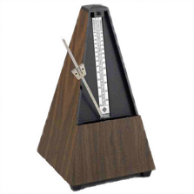
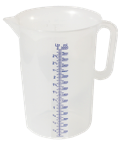

Scalar Timing Theory

Slide 48

Scalar Timing Theory
2
4
1
3
Notes:
Red or green (left or right) longer on the screen?

Slide 49
Scalar Timing Theory
2
1
3
4
Notes:
It could be, of course, that instead of a perfect match, an “close match” would have been sufficient to trigger the “same” response.

Slide 50
Scalar Timing Theory
3
4
Green or Red?
Red
Notes:
It could be, of course, that instead of a perfect match, an “close match” would have been sufficient to trigger the “same” response. But what determines whether a match is “close”? Well, these types of models don’t provide us with an answer…

Slide 51
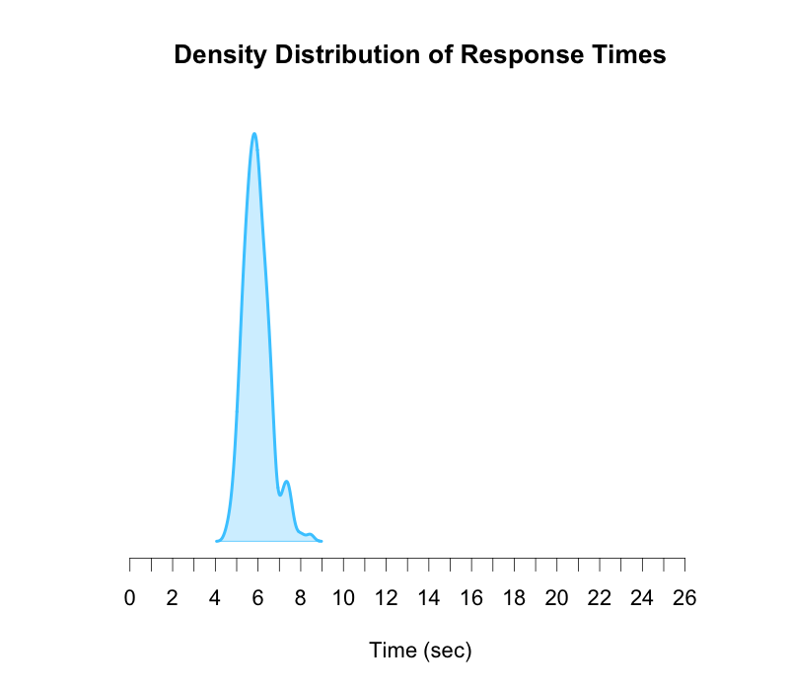
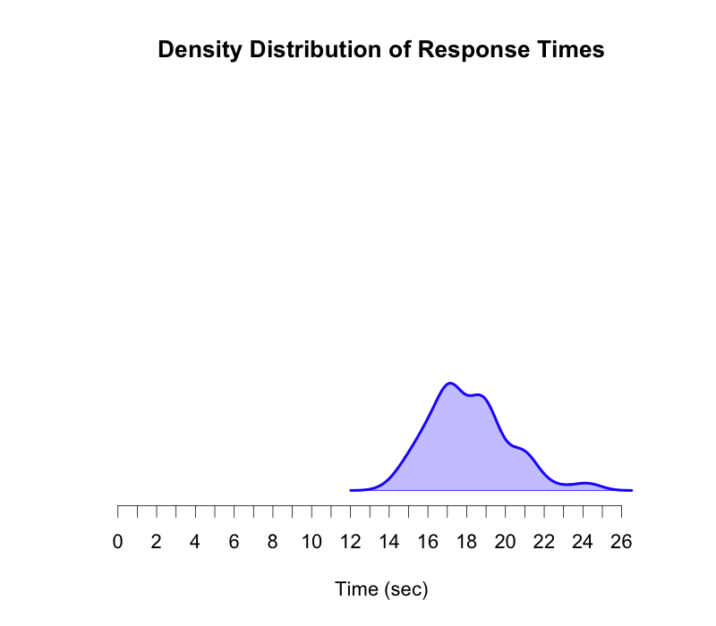
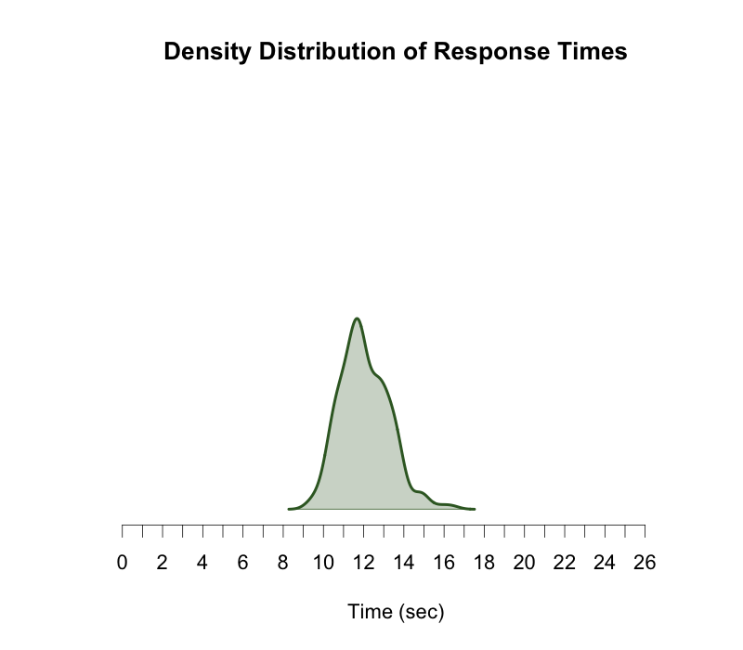
Model trained
at 6s
Model trained
at 12s
Model trained
at 18s
cf. Matell & Meck (2004)

Slide 52
IP Models of Interval Timing
Notes:
It could be, of course, that instead of a perfect match, an “close match” would have been sufficient to trigger the “same” response. But what determines whether a match is “close”? Well, these types of models don’t provide us with an answer…

Slide 53
Scalar Timing Theory
Church, 2003

Slide 54
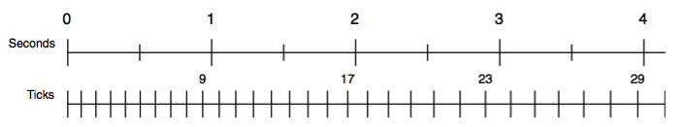
Timing in ACT-R
Idea: Metronome that starts ticking fast, but gradually slows down
The current value of the accumulator is available to the rest of cognition
At any moment, the accumulator can be read or matched in the condition of a production

Slide 55
Stochastic Process
t₀ = length of starting pulse
t_{n+1}= a x t_{n} + noise(M=0,SD=b x a x t_{n})
Noise = logistic noise (ACT-R default, normal-like)
Two sets of parameters:
t₀ = 11 ms, a = 1.1, b = 0.015 t₀ = 100 ms, a = 1.02, b = 0.015

Slide 56
Assignment for the next week
Implement the ACT-R timing module
Specifically, you will need
A function that converts pulses into time
A function that converts time into pulses
Demonstrate that it can recreate the scalar property
More information will be posted on Nestor.
Assignment will not be graded, but is part of bisection assignment.

